Slide 1


Slide 2
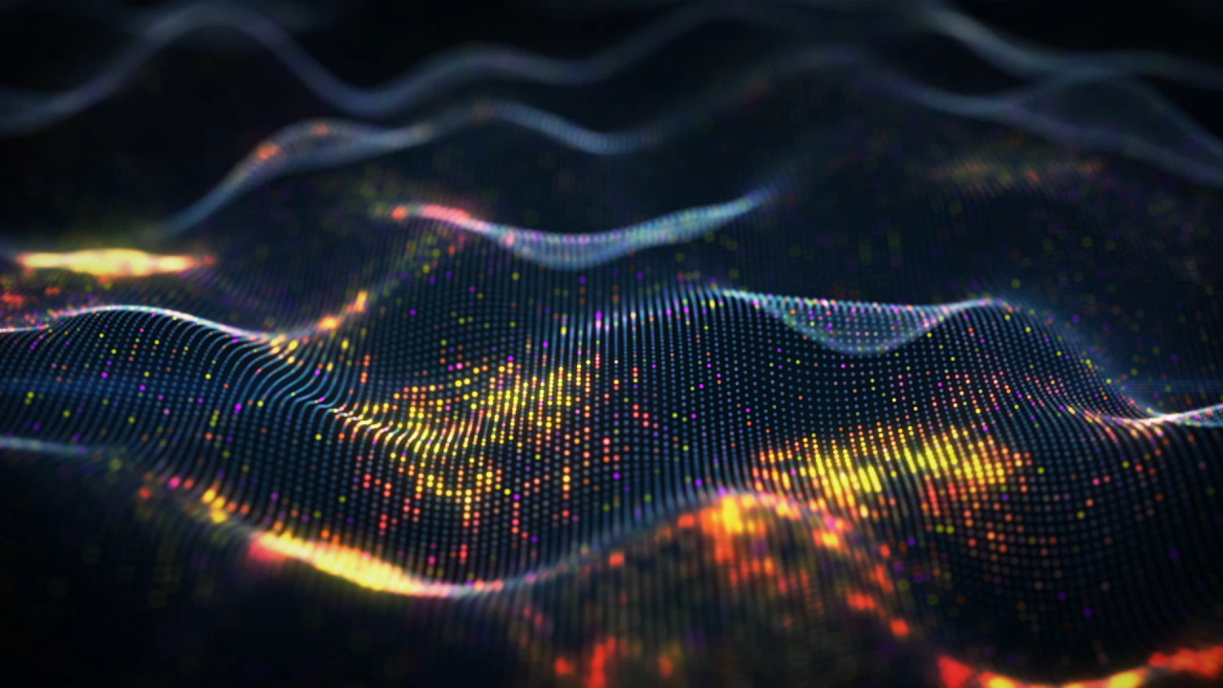


The quantum threat is here... Is your messaging ready?
parrobe@uk.ibm.com
Rob Parker
Security Architect, IBM MQ
https://mastodon.social/@robparkertech
https://www.linkedin.com/in/robert-parker-3403475a/

Slide 3
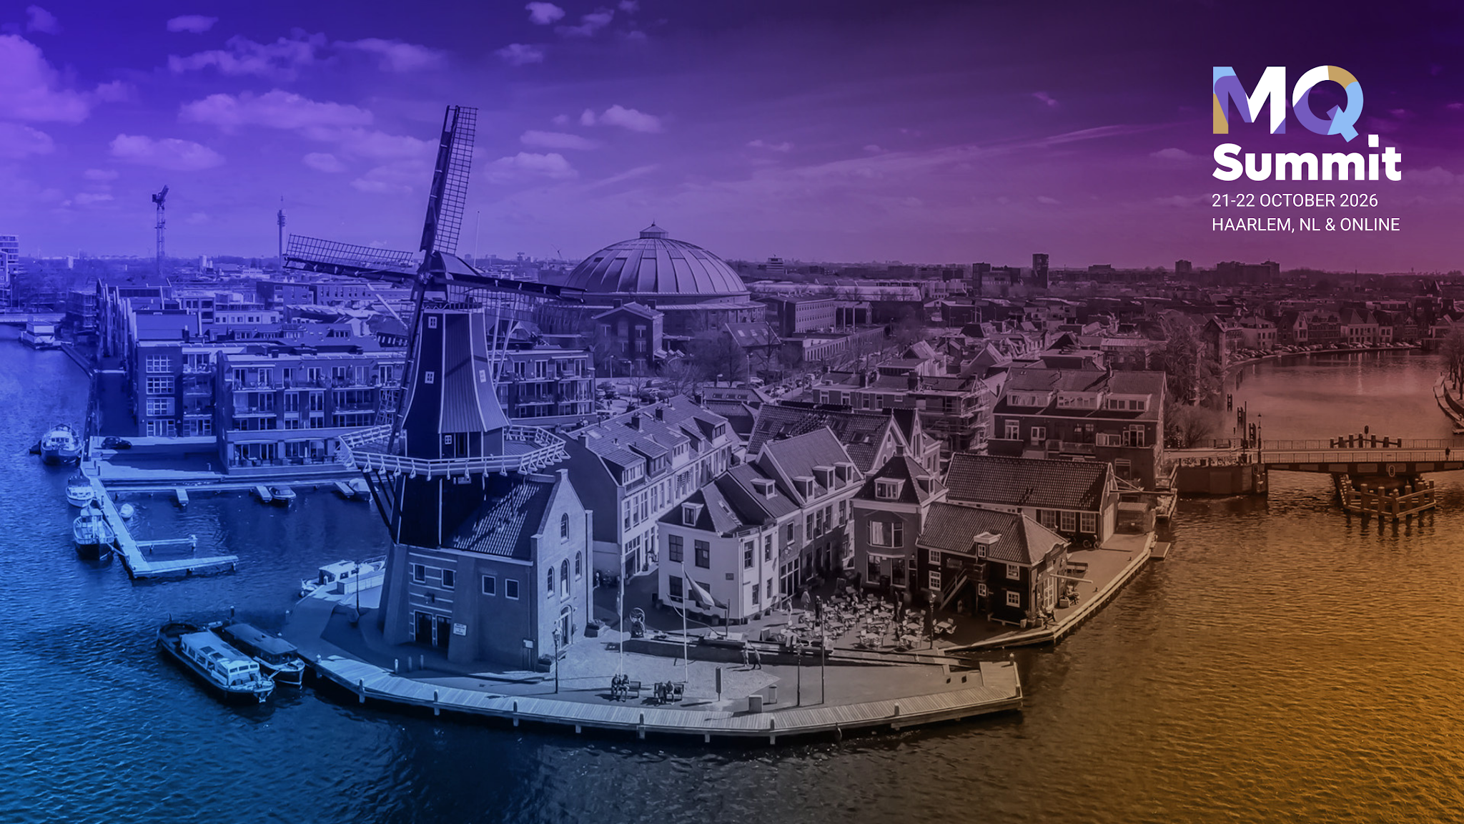
The quantum threat is here... Is your messaging ready?
parrobe@uk.ibm.com
Rob Parker
Security Architect, IBM MQ
https://mastodon.social/@robparkertech
https://www.linkedin.com/in/robert-parker-3403475a/

Slide 4

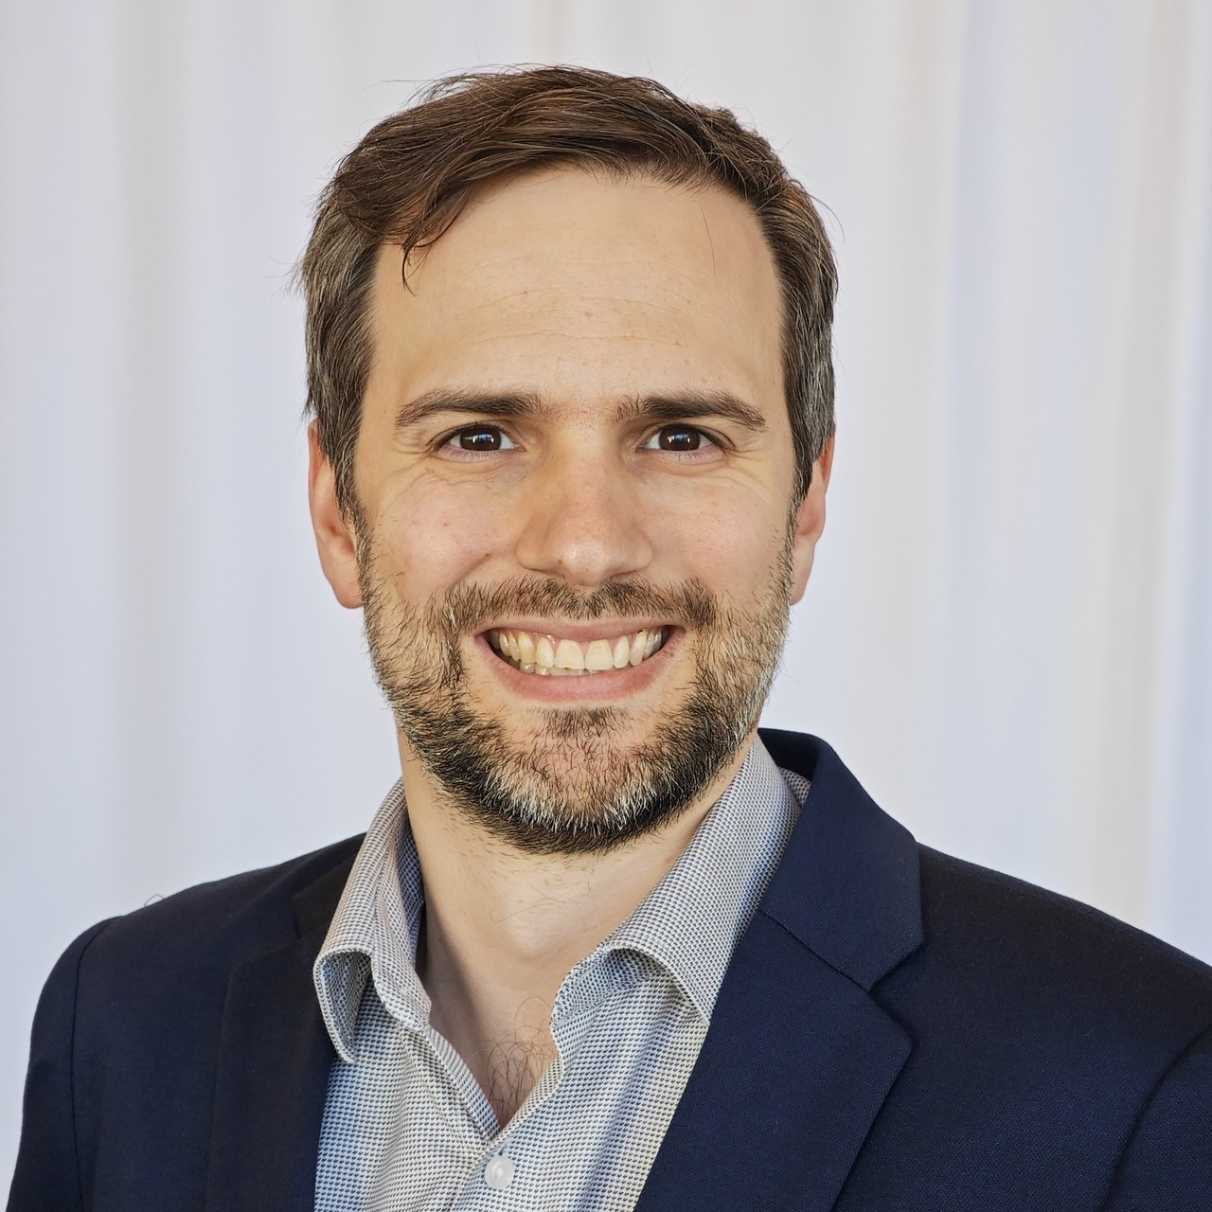
Who am i?
Joined IBM MQ in 2012
Worked on security, containers, cloud.
Appointed Security Architect for IBM MQ in 2018
  Leads security development from design to development to release.

Slide 5
Let’s talk.
Quantum Computing
Quantum Threat
Why this affects messaging.
What does it take to be Quantum Secure?
Conclusions

Slide 6

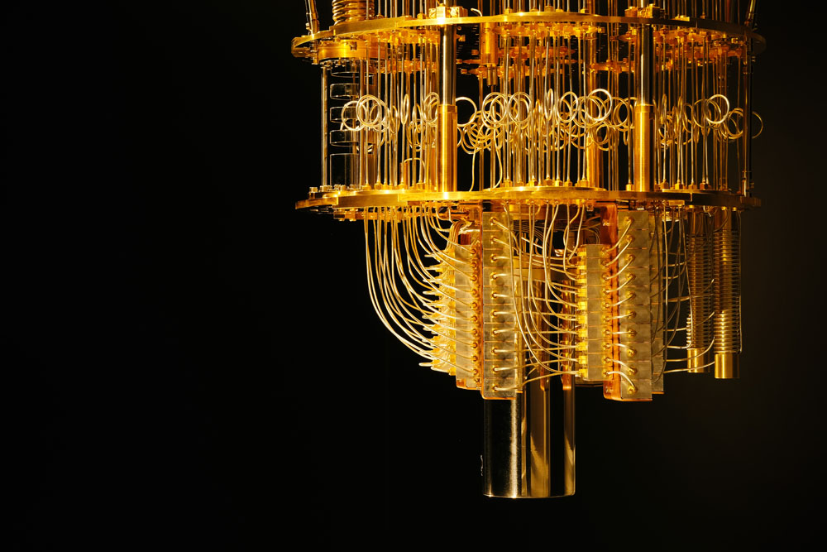
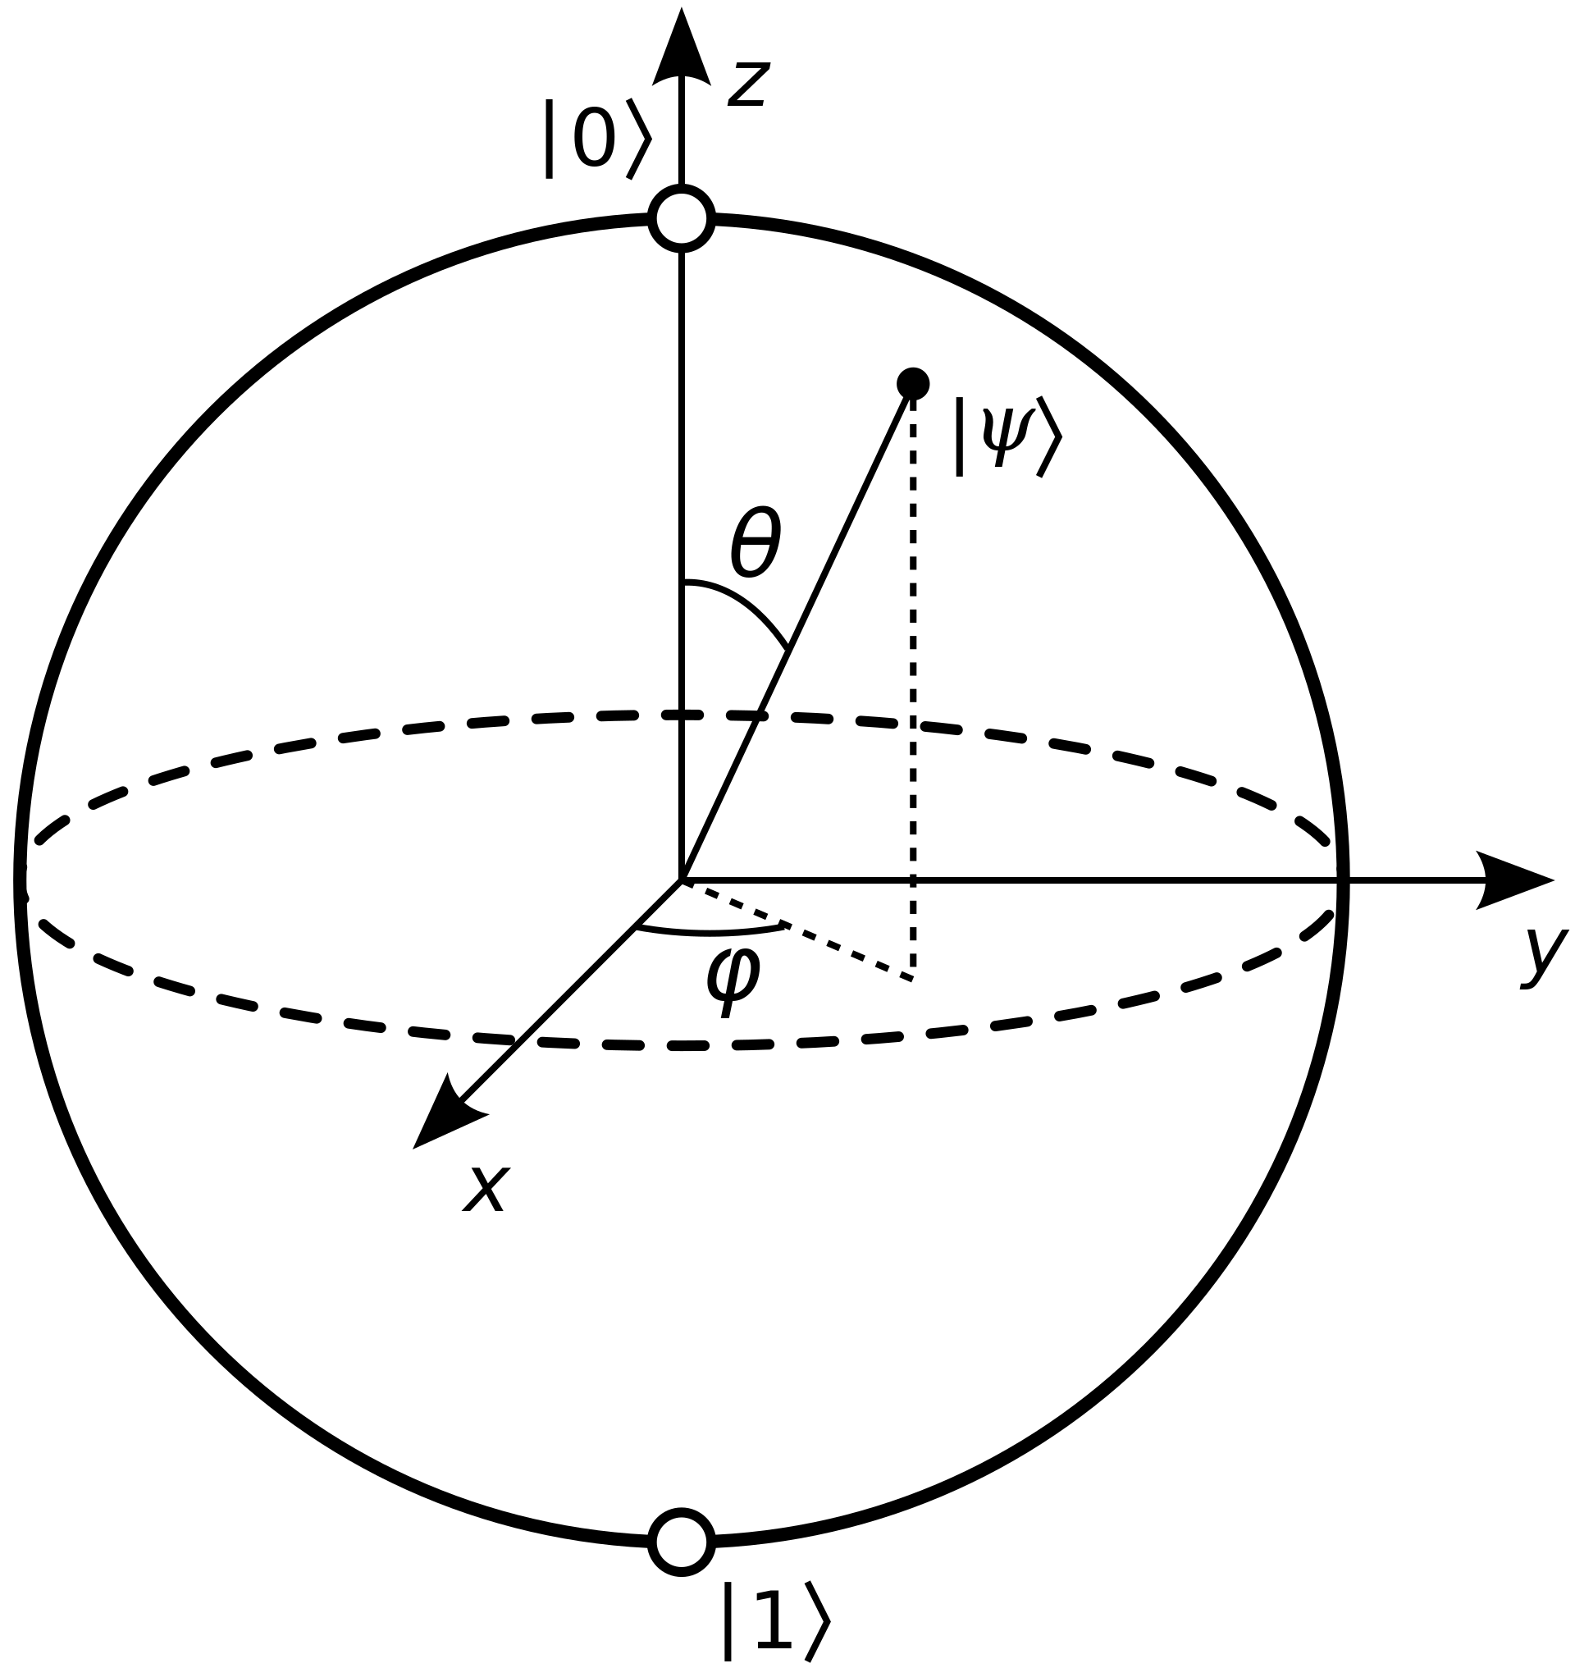
Quantum computers are a new way of computing data.
qubit
Notes:
Image source: https://newsroom.ibm.com/media-quantum-innovation?keywords=quantum&l=100#gallery_gallery_0:21747
Classical computers use 1’s and 0’s to represent data. These bits are either 1 or 0 and storage of the value is easy.
Quantum computers use quantum phenomena such as superposition and entanglement to perform computations. A superposistion is where a bit exists in both states at once 0 and 1 as opposed to being 1 or 0. Quantum computers use qubits in quantum states to represent data. Using Qubits you can store 2^{n} bits of data using superpositions of multiple qubits. Using superposistion you can calculate permutations of the same bits of data in parallel. But doing so is destructive to the state of the quantum bits.

Slide 7
Predicting complex molecule interaction
Calculating optimum routes in large possibilities.
Factorizing massive prime numbers, reversing math formula with many permutations.
Notes:
Image source: https://newsroom.ibm.com/media-quantum-innovation?keywords=quantum&l=100#gallery_gallery_0:21747
Classical computers use 1’s and 0’s to represent data. These bits are either 1 or 0 and storage of the value is easy.
Quantum computers use quantum phenomena such as superposition and entanglement to perform computations. A superposistion is where a bit exists in both states at once 0 and 1 as opposed to being 1 or 0. Quantum computers use qubits in quantum states to represent data. Using Qubits you can store 2^{n} bits of data using superpositions of multiple qubits. Using superposistion you can calculate permutations of the same bits of data in parallel. But doing so is destructive to the state of the quantum bits.

Slide 8


The Quantum Threat

Slide 9
Types of Cryptography
Symmetric
Asymmetric
Encryption/Decryption
Authentication
Data Signing
Hashing

Slide 10
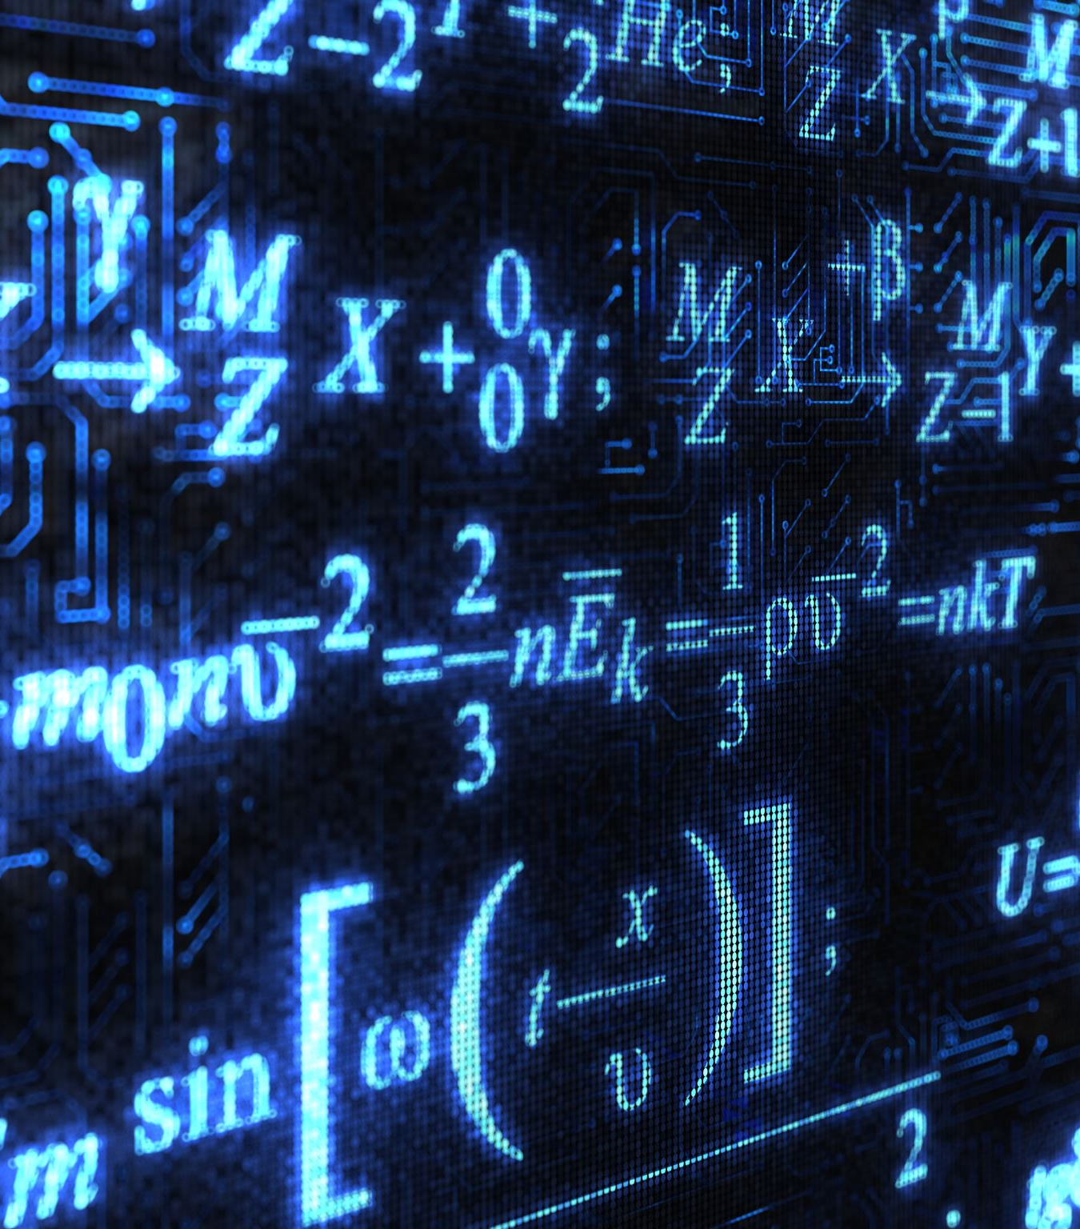
Quantum Computers versus Cryptography
Cryptography is transforming data using complex formulas with many permutations
Symmetric
Asymmetric
Grover’s algorithm (1996)
Shor’s algorithm (1994)

Slide 11
Cryptosystem | Category | Key Size | Quantum algorithm to defeat | Logical Qubits required | Physical Qubits required | Time to break
AES-GCM | Symmetric encryption | 128 192 256 | Grover’s Algorithm | 2,953 4,449 6,681 | 4.61 × 10⁶ 1.68 × 10⁷ 3.36 × 10⁷ | 2.61 × 10¹² Years 1.97 × 10²² Years 2.29 × 10³² Years
RSA | Asymmetric Encryption | 1024 2048 4096 | Shor’s Algorithm | 2,050 4,098 8,194 | 8.05 × 10⁶ 8.56 × 10⁶ 1.12 × 10⁷ | 3.58 hours 28.63 hours 229 hours
ECC Discrete-log problem | Asymmetric Encryption | 256 384 521 | Shor’s Algorithm | 2,330 3,484 4,719 | 8.56 × 10⁶ 9.05 × 10⁶ 1.13 × 10⁶ | 10.5 hours 37.67 hours 55 hours
SHA256 | Hashing | N/A | Grover’s Algorithm | 2,403 | 2.23 × 10⁶ | 1.8 x 10⁴ Years
PBKDF2 With 10K iterations | Password Hashing | N/A | Grover’s Algorithm | 2,403 | 2.23× 10⁶ | 2.3 x 10⁷ Years
4 Quantum Computing's Implications for Cryptography." National Academies of Sciences, Engineering, and Medicine. 2019. Quantum Computing: Progress and Prospects. Washington, DC: The National Academies Press. doi: 10.17226/25196. National Academies of Sciences, Engineering, and Medicine. 2019. Quantum Computing: Progress and Prospects. Washington, DC: The National Academies Press. https://doi.org/10.17226/25196 .
Notes:
https://nap.nationalacademies.org/read/25196/chapter/6#98
This table shows that with a sufficiently powerful quantum computer and using Shor’s algorithm, you could crack RSA or Elliptic Curve encryption within hours. Meaning someone could then listen in to your conversations unless you changed your RSA/EC keys.
Ouch.
Shor’s algorithm - Quantum algorithm for integer factorization (find prime factors of aQuantum algorithm for integer factorization (find prime factors of alarge integer) – 1994 by Peter Shor
Grover’s Algorithm - Quantum algorithm for unstructured search. (Brute force faster) – 1996 by Lov Grover
And this is why we focus on Shor’s. It completely breaks Asymmetric cryptography.
Grover’s impacts symmetric but the O notation is effectively $𝒪\left(\sqrt{n}\right)$ Which means that it will take a Quantum computer the same amount of time to break a AES-128 bit key as it will take a traditional computer to break an AES-64 bit key. So to get back to the standards of protection for today, we can _just_ double our key size. But even then, that is low priority given AES-128 break time is still many many years.
One thing though, is the fact this is theoretical speed (again proven algorithm and capability just a matter of scale). To be able to achieve these speeds we need a quantum computer of the highlighted capacity…

Slide 12
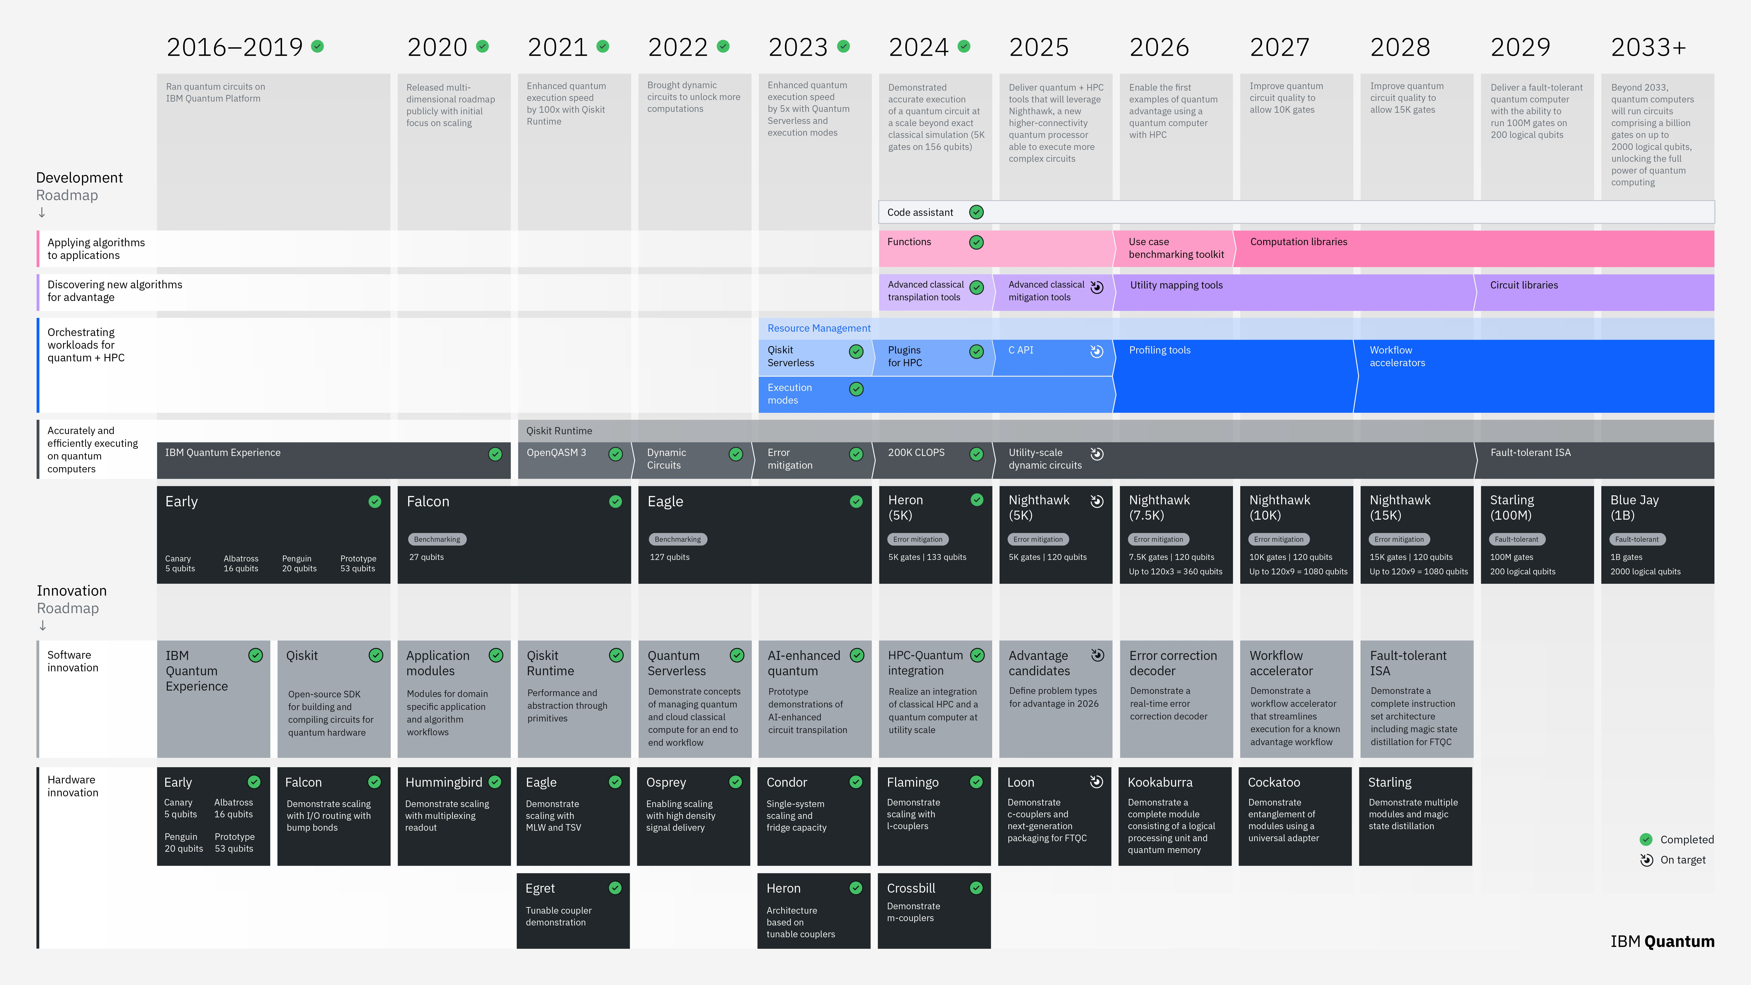
https://www.ibm.com/quantum/blog/large-scale-ftqc
Notes:
And this is IBMs roadmaps. Blue Jay on the far right is postered as going to have the necessary Qubits to achieve the speeds from before. This means 2033 could see a quantum computer that can break encryption. 7 years away.
Although it’s important to highlight to get there, there are a lot of steps and innovations that need to be met to achieve this goal.

Slide 13

7+ years?
Only “if”?
Let’s
relax!

Slide 14

7+ years?
Only “if”?
Let’s relax!

Slide 15
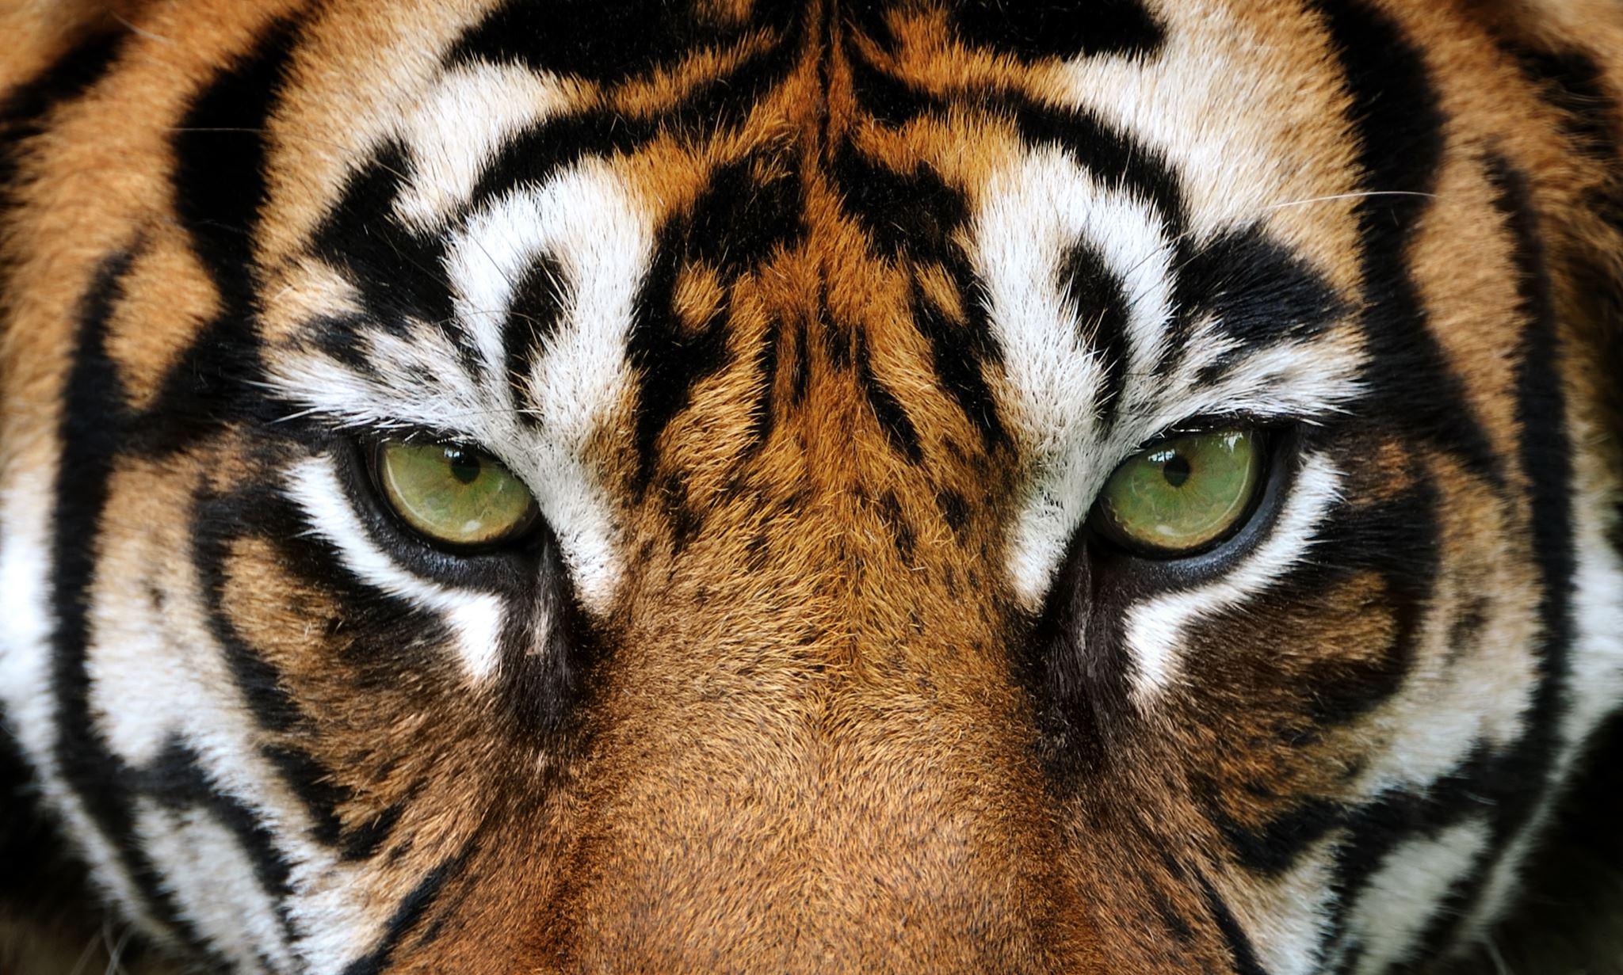

Slide 16
Cryptography In a TLS handshake
Encrypted Data
Authentication
Key Exchange
Asymmetric
Symmetric
Notes:
We’ll be looking at one use case though. TLS. This shows the TLS handshake (blue boxes) and an abstract of what is needed to be done in the TLS handshake before we start sending encrypted application data.
Authenticate. The TLS server (and sometimes the TLS client as well) will have a certificate that needs to be validated by the other side. This uses PKI cryptography to assert we are talking to who we expect to and that we trust them.
Key Exchange. This is where we exchange the key we will be using for the encrypting the application data. We want to use a symmetric algorithm like AES for this as it is performant but we need to exchange a unique symmetric key. This step achieves that. Commonly it is done using Diffie-Helmen.

Slide 17
Why care now? – Harvest Now Decrypt Later
Encrypted Data
Key Exchange
Asymmetric
Symmetric
Notes:
So 7 years to go, why should anyone care now.
Well attacks will always go for the weakest part of a system. And we if we look at the TLS handshake the asymmetric part is the weakest. Unfortunately, the way that encryption works is that if you know the key you can decrypt and as part of the TLS handshake shares the key we could attack this key share to obtain the key and read data.
So TLS handshakes today would be weak against Quantum Computers because we could either:
Attack the Authentication stage to impersonate someone
Attack the key exchange stage to be able to read/modify encrypted data.
But all of this requires a quantum computer to exists! So why care now?

Slide 18
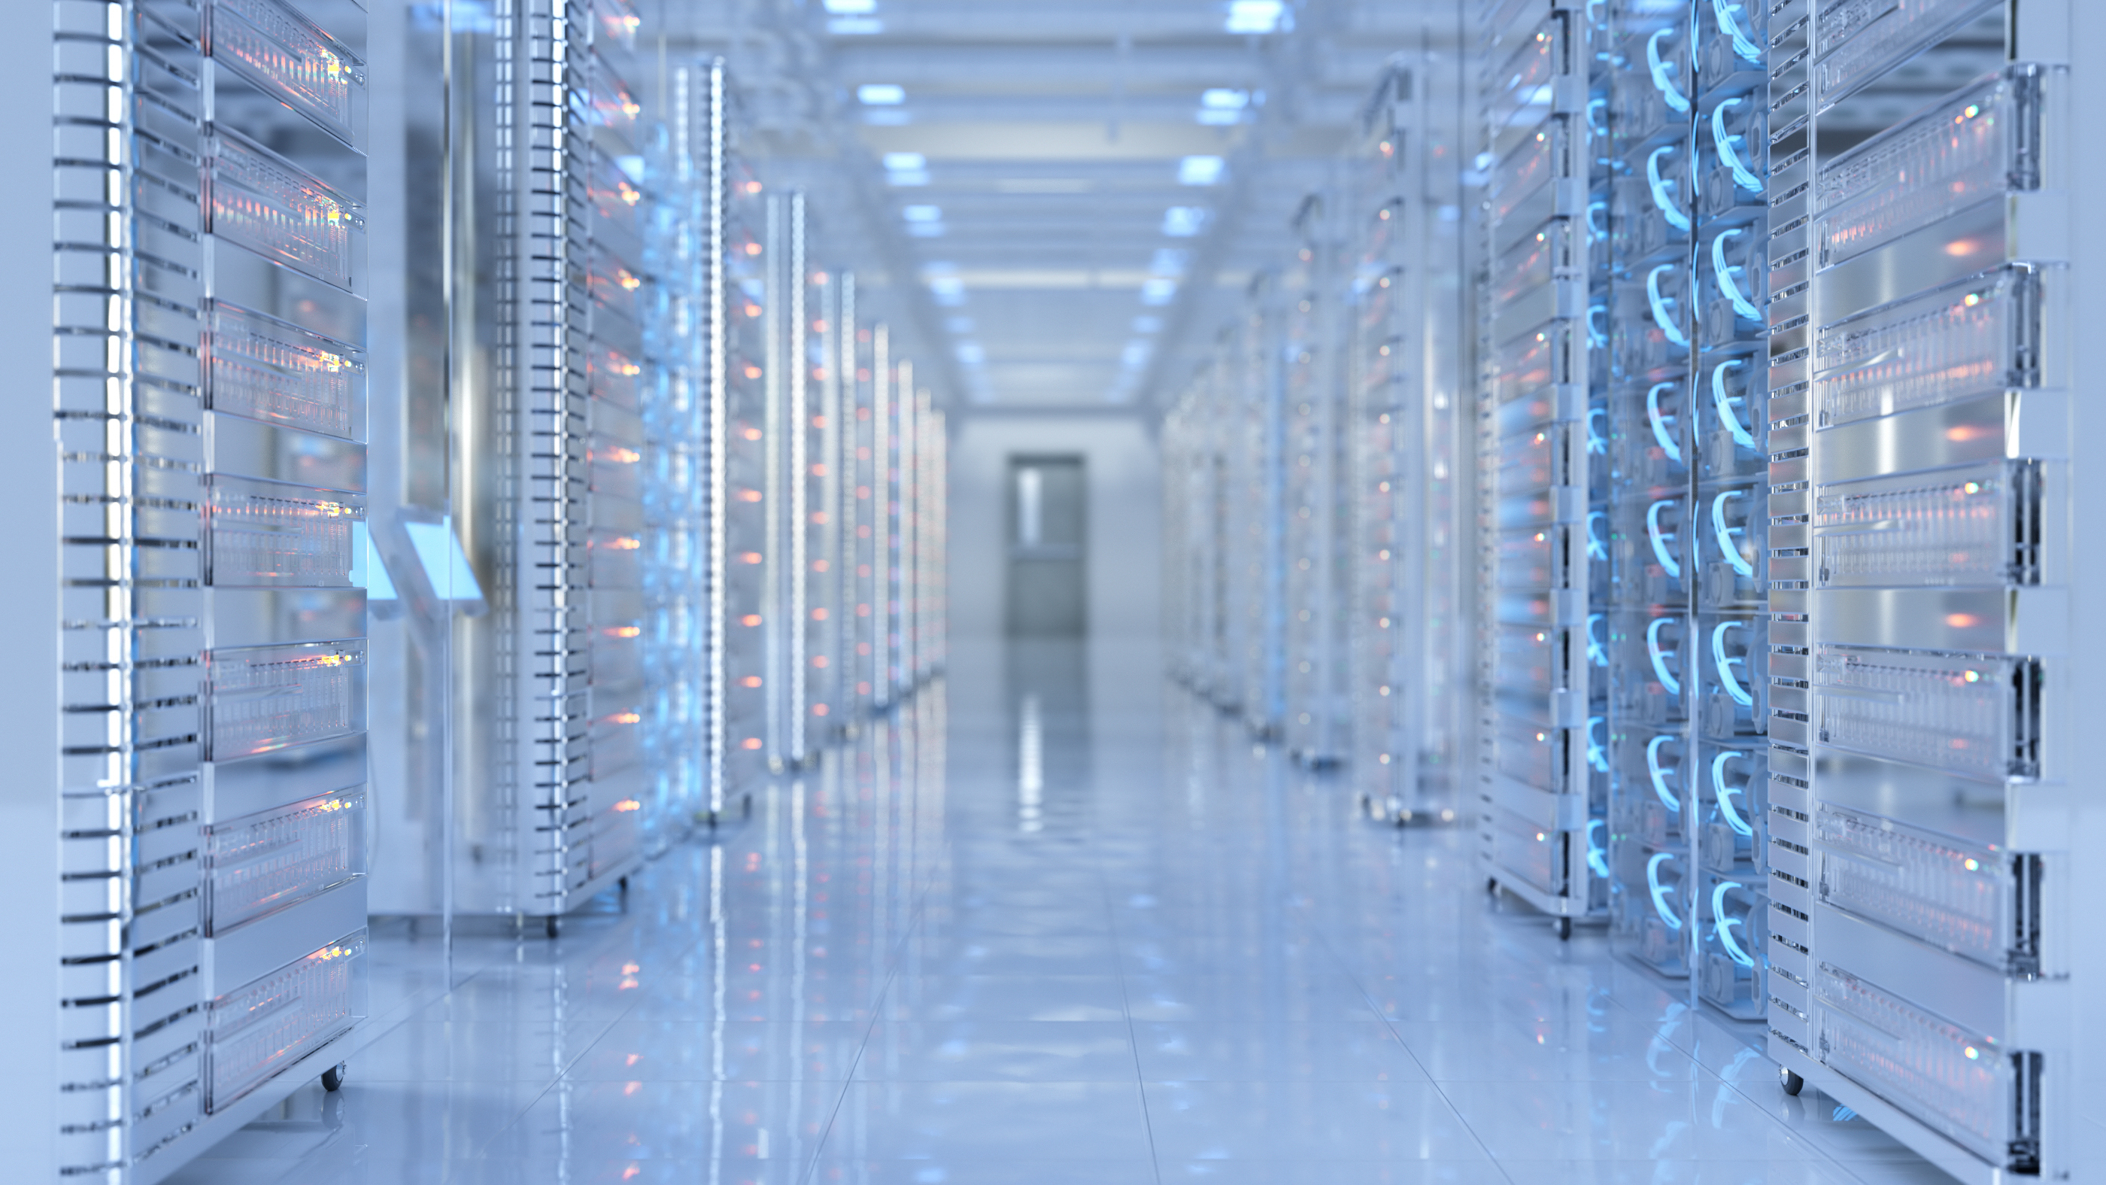
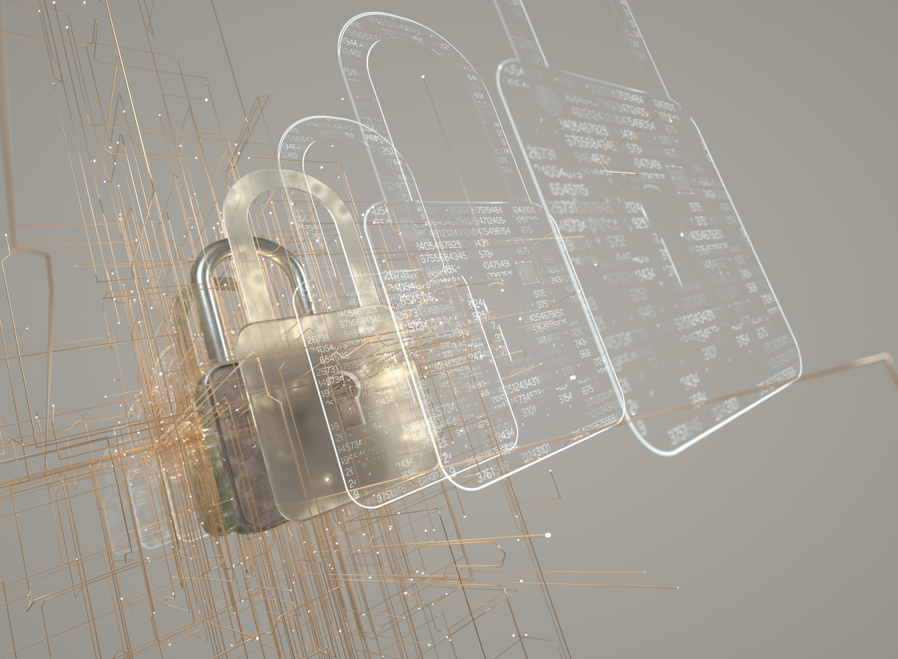
Why care now? – Harvest Now Decrypt Later
Harvest Now
Decrypt Later
Notes:
Because let’s assume someone just listens to all the TLS communication in the world.
It’s easy to see when a TLS handshake happens and the data that is transmitted after. So, we could store all of that in a data vault.
Then 7 years time, we run it through a quantum computer and get the key to decrypt it.
Harvest Now, Decrypt later.
Does this matter? Well that depends on your data. For me personally, probably not? My credit card numbers will expire in a few years. I don’t send anything that in 7 years will be relevant still. But some companies and industries do care. 7 Years is a short time. Their data will be relevant and it needs to be protected.

Slide 19

How this impacts messaging

Slide 20
Producers
Broker
Broker
Consumers
App
App
Broker
TLS
App
At-Rest Encryption
App
End to End Encryption
Broker
Broker
Installation drivers
Broker

Slide 21
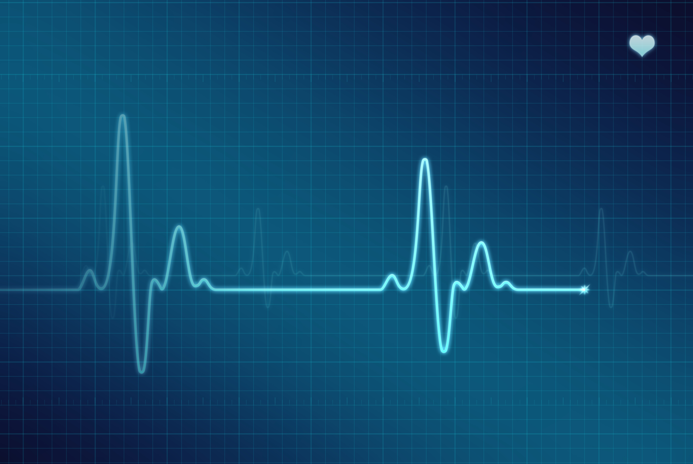
The Quantum “cure”

Slide 22
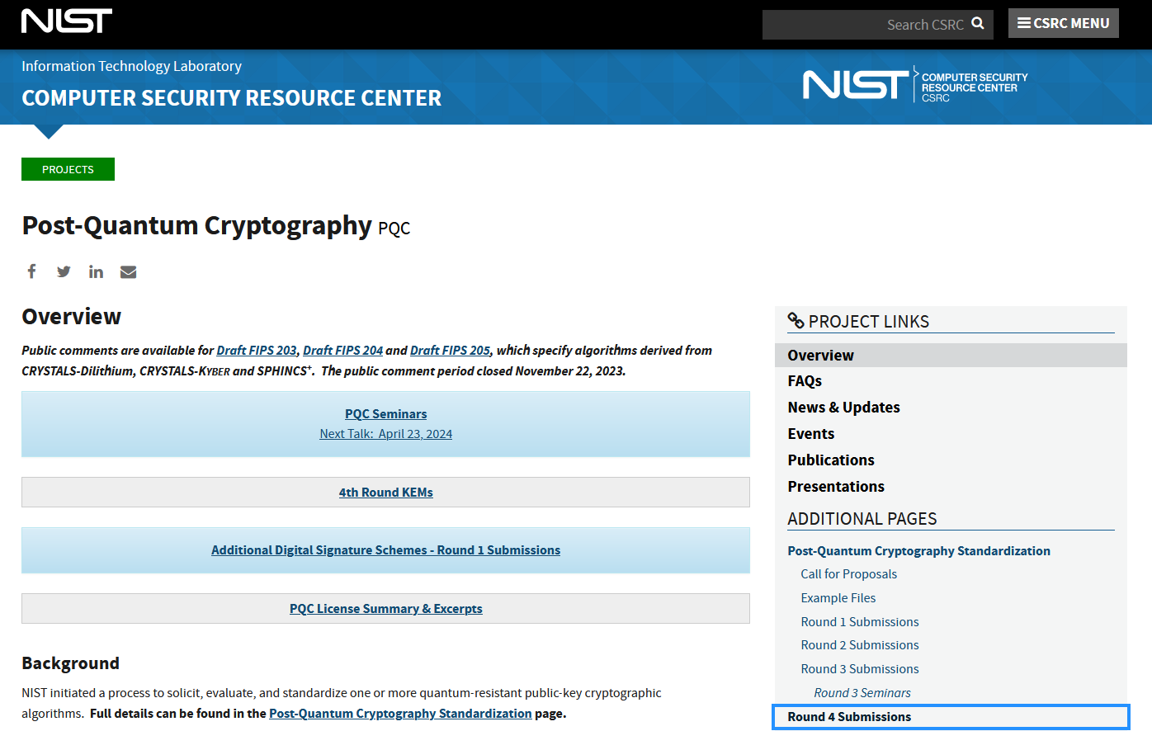
2016
https://csrc.nist.gov/projects/post-quantum-cryptography
Notes:
So we’re doomed. But what has been happening to protect this?
NIST has a dedicated page for PQC. They started work in 2016.

Slide 23
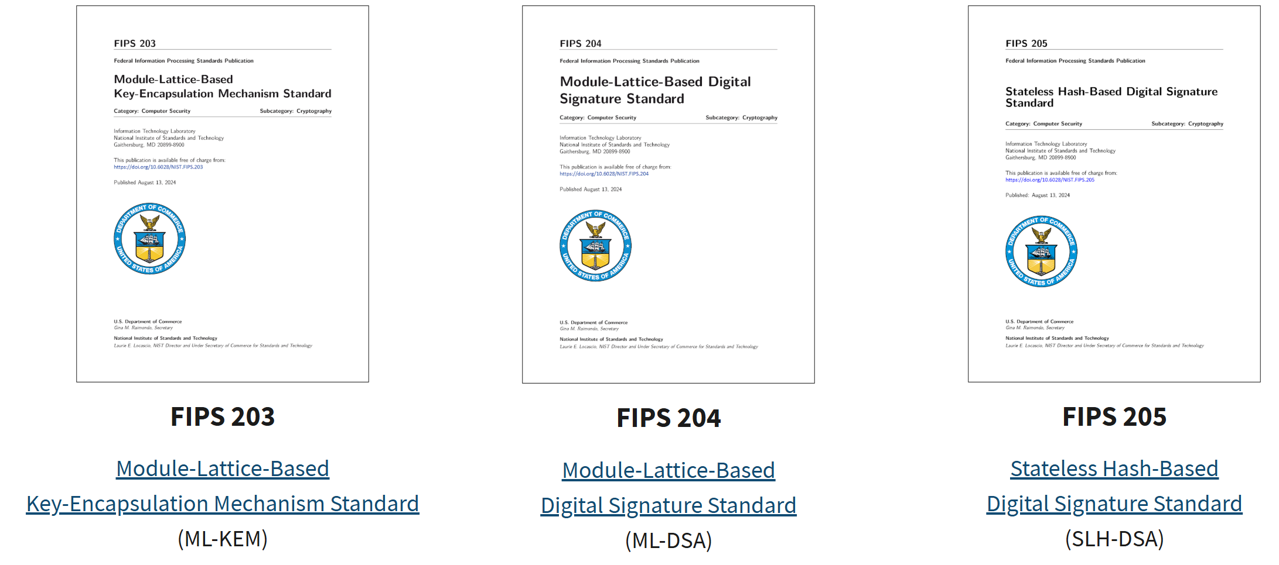
August 2024, NIST released its principal PQC standards

Slide 24
ML-DSA
ML-KEM
AES-256
Encrypted Data
Authentication
Key Exchange
Notes:
Here are what the algorithms protect.

Slide 25
Building a fully Quantum-Safe messaging platform
Today:
Quantum-safe TLS key exchange
Protection against future decryption attacks
Next:
Quantum-safe signing capabilities
Continued standards alignment
Phase 1: Evaluation
Understand PQC impact
Test interoperability
Validate operational processes
Phase 2: Pilot
Protect selected high-value channels
Evaluate performance and certificate lifecycle impacts
Phase 3: Enterprise Rollout
Expand as client support broadens
Align with organisation-wide PQC strategy
Protect critical messaging infrastructure

Slide 26
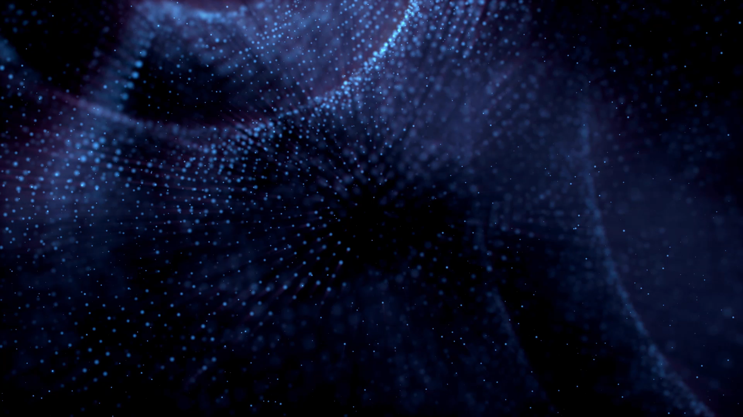
Conclusions

Slide 27
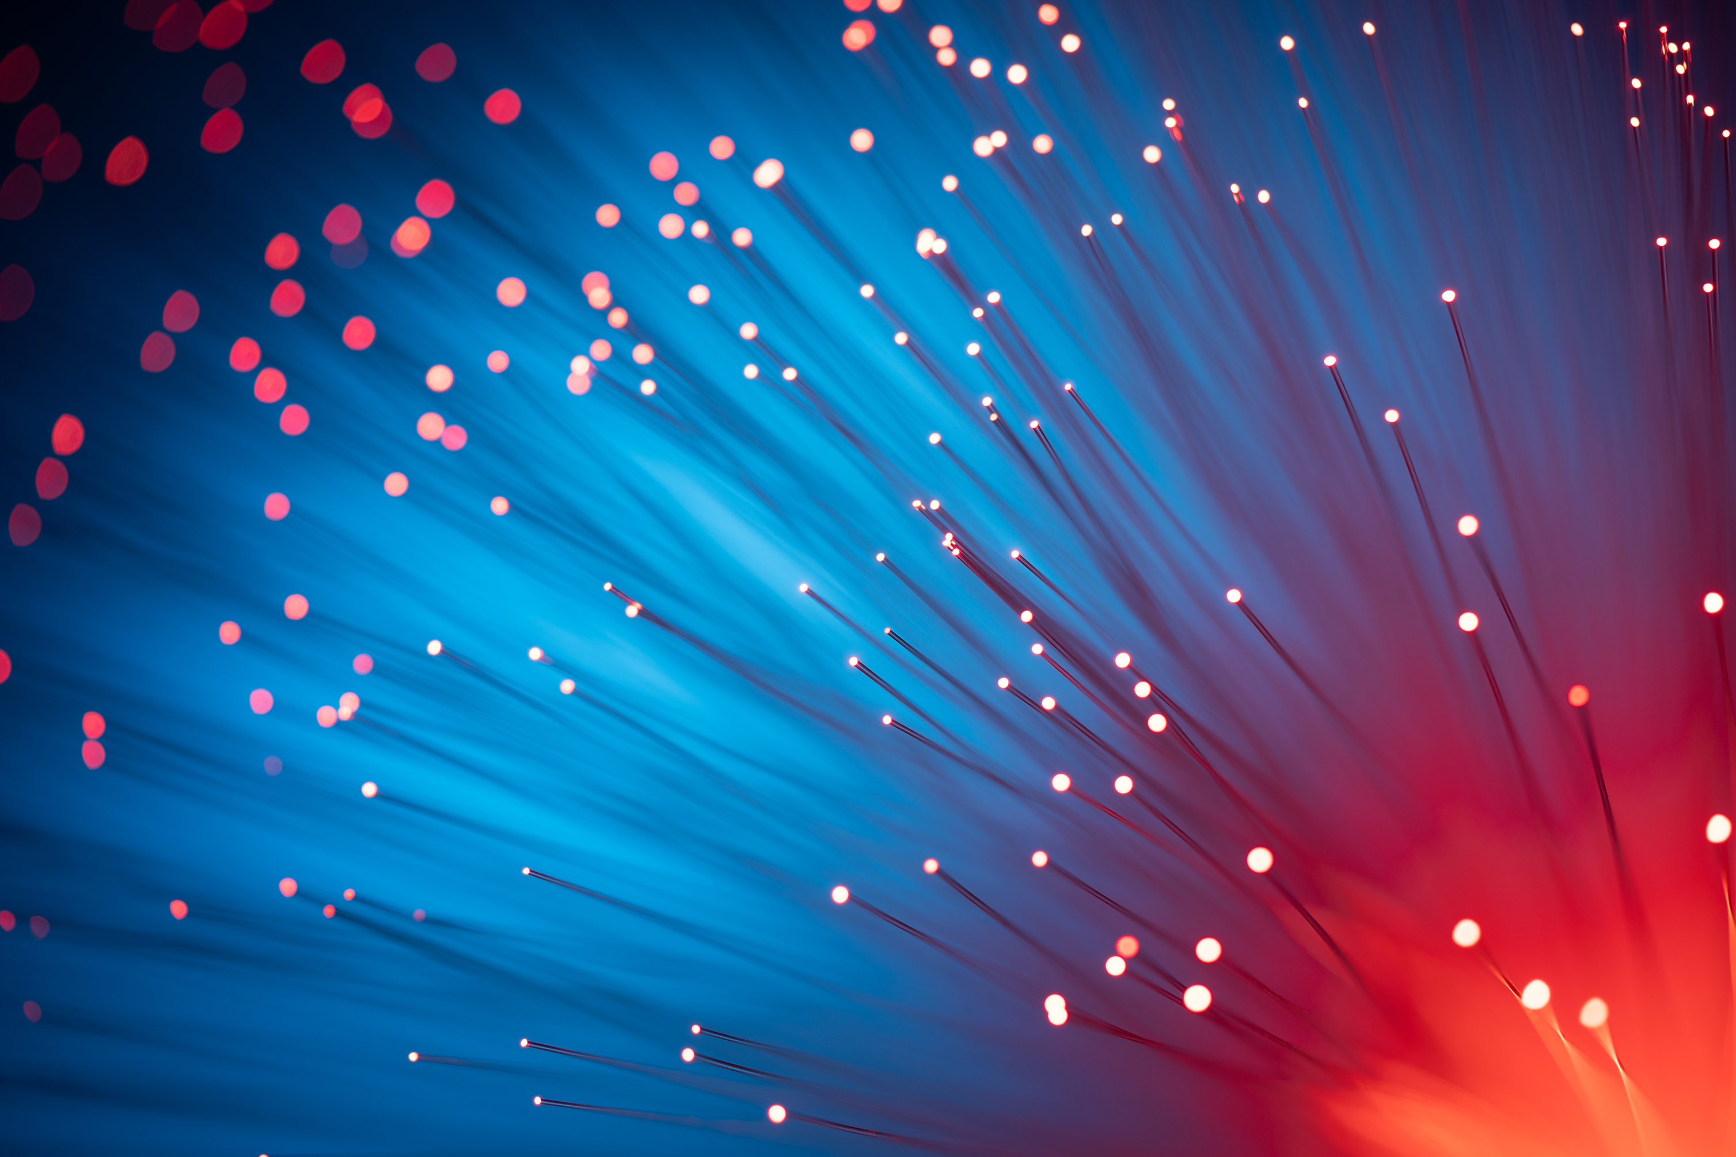
Conclusions

Slide 28
Summary
Quantum Computers are proven to break encryption.
It’s a matter of when, not if.
Cryptography and encryption are used throughout a system. Not just in one area.
Action is needed now to protect against Harvest Now, Decrypt Later attacks.
Future action will be needed to protect from impersonation attacks.
Products, service owners should take this threat seriously and act.
Providing quantum safe protection is a must.
Notes:
As slide

Slide 29
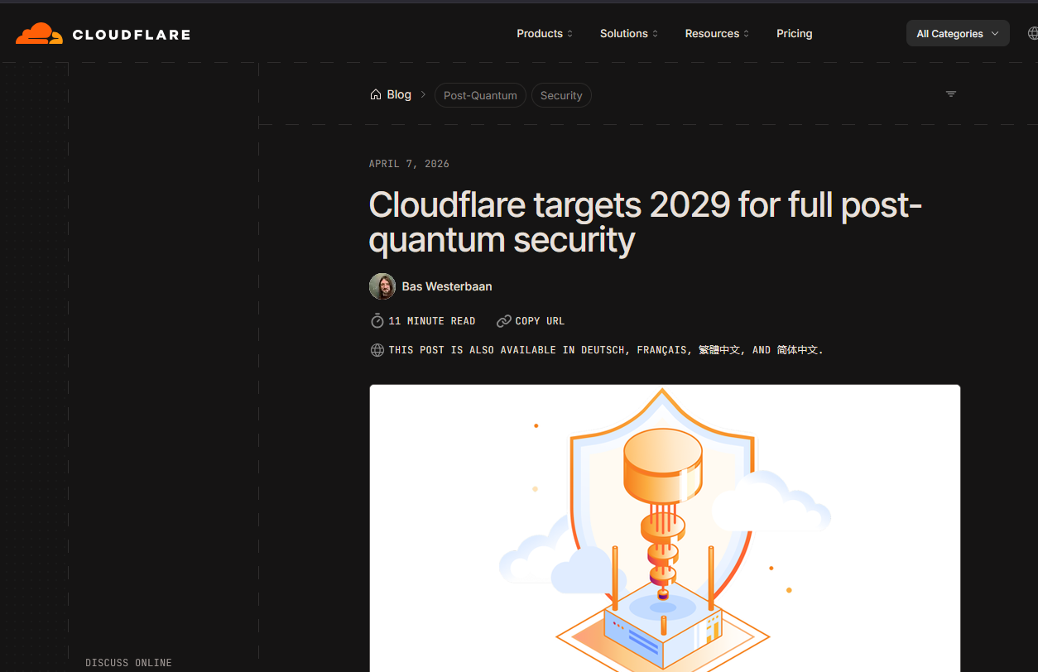
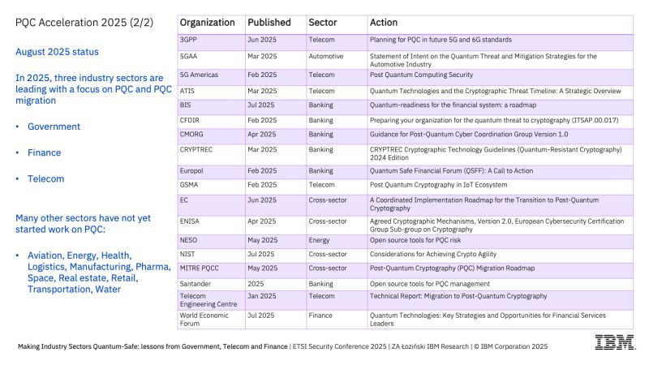
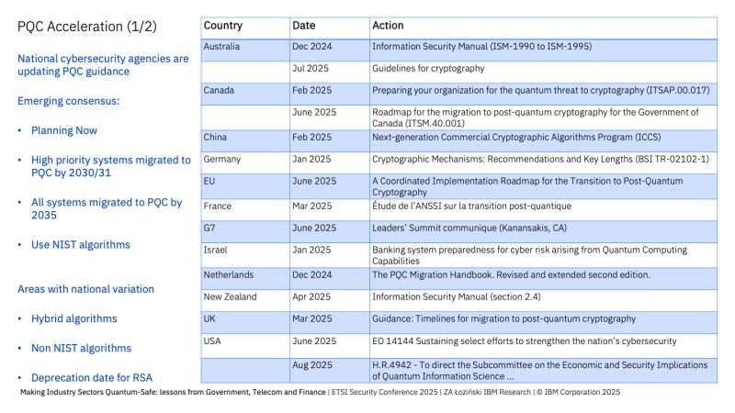
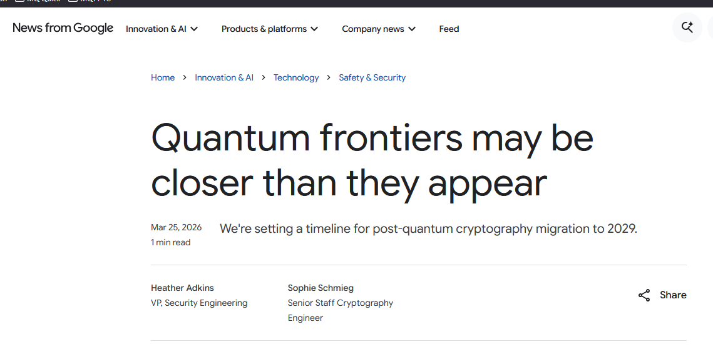
Why care now? – regulatory timelines
Industry PQC Guidance
Government PQC Guidance
Notes:
https://blog.google/innovation-and-ai/technology/safety-security/cryptography-migration-timeline/
https://blog.cloudflare.com/post-quantum-roadmap/
But this is not limited to just IBM saying it, industries, governments, the white house, cloudflare, google etc are all pushing for PQC migration at a timely speed to help protect systems.

Slide 30
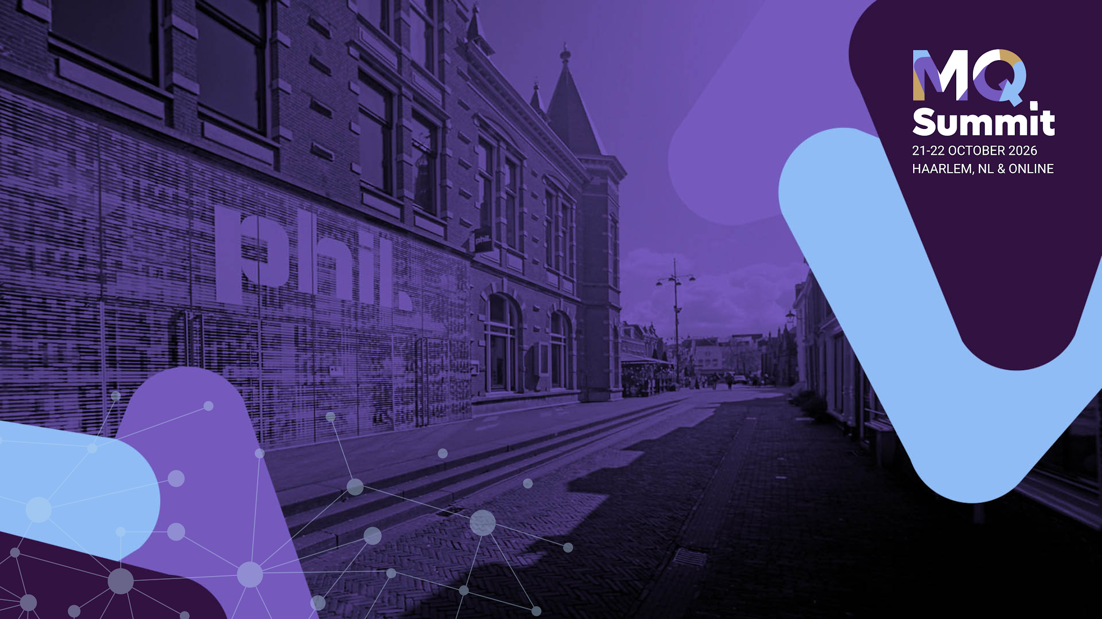
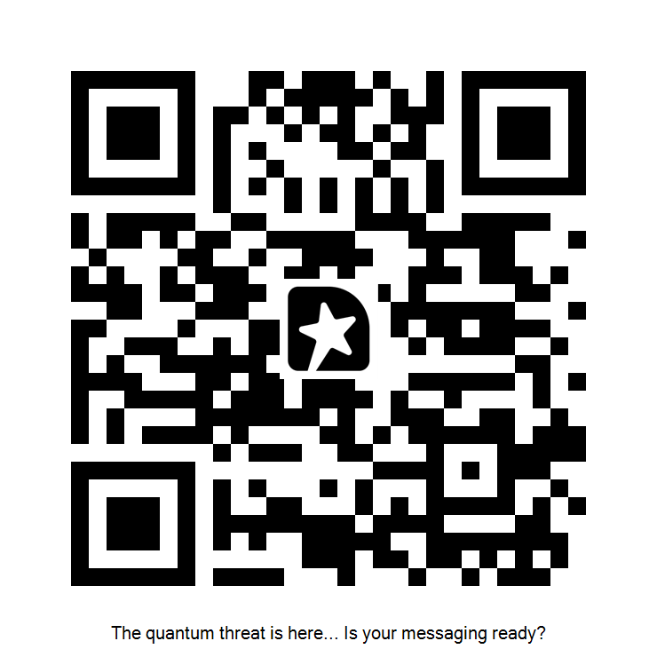
The quantum threat is here... Is your messaging ready?
Thank you, Bedankt, Danke, Gracias, Merci, Grazie,
ありがとう, Obrigado, Dhanyavad, 谢谢, Teşekkürler, 고마워, Dzięki, شكرًا, Tak, Děkuji vám, Mahalo, Kiitos, Takk …
Rob Parker
Security Architect, IBM MQ
parrobe@uk.ibm.com
https://mastodon.social/@robparkertech
https://www.linkedin.com/in/robert-parker-3403475a/

Slide 31


